Slide 1


Meet JAMES: THE BUDDING ENTREPRENEUR

Slide 2



Slide 3



Slide 4

BUAN 6390
ANALYTICS PRACTICUM
Marketing Campaign
Effectiveness

Slide 5
Introduction
Project Overview:
This project analyzes marketing campaigns across industries and demographics to identify strategies—like optimal channels, content types, and target audiences—that consistently deliver the best ROI, helping businesses optimize their marketing efforts.
Objectives:
Assess channel effectiveness
Analyze campaign type impact
Understand Target Audience influence
Evaluate cost efficiency
Develop best practices
Problem Statement:
Billions of dollar spent on marketing every year but companies do not get the desired results
Potential Impact:
Optimized marketing budgets
Improved customer targeting
Enhanced marketing ROI
Strategic competitive advantage
Guidance for Large and Small businesses

Slide 6




Data
16 Columns
200,000 Observations
1 year
(Jan 2021 - Dec 2021)

Slide 7






Diving into the Data
Clicks
Engagement Score
Company Name
Impressions
Location
Campaign Type
Acquisition Cost
Columns
Channel Used
ROI
Language
NO MISSING VALUES
Duration
Customer Segement
Clicks
Conversion Rate
Data Types Integer Float String
Date/Time
Target Audience

Slide 8


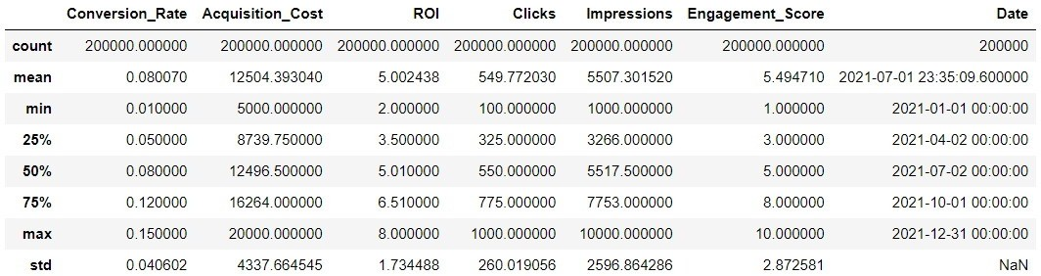


Data Preprocessing
Tasks
Column Name Cleaning Data Type conversion Monetary Data Cleaning
Exploration of target variables (numeric)
Why not categorical to numerical???

Slide 9

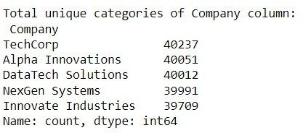
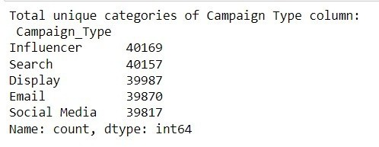
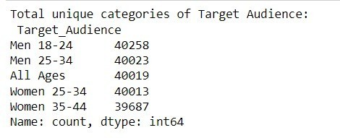
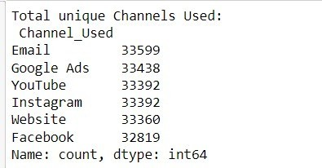
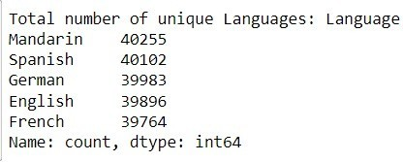
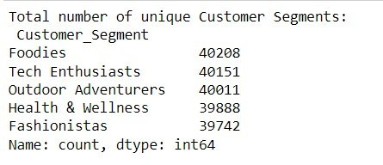
Data Preprocessing
Exploration of target variables (categorical)

Slide 10
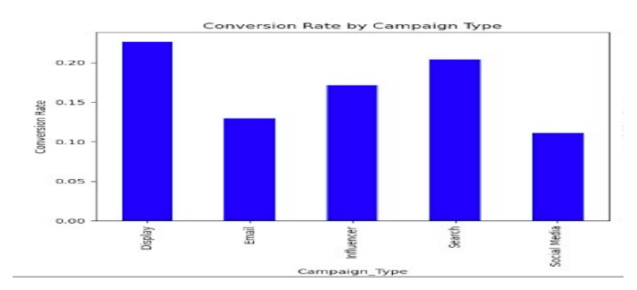
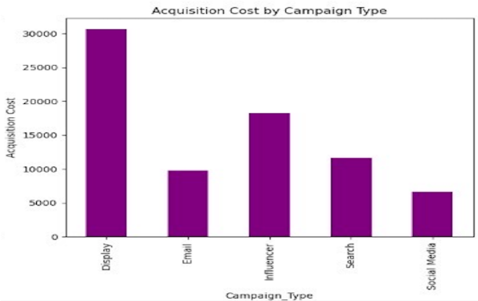
Exploratory Data Analysis
Conversion Rate by Campaign Type
Acquisition Cost by Campaign Type

Slide 11
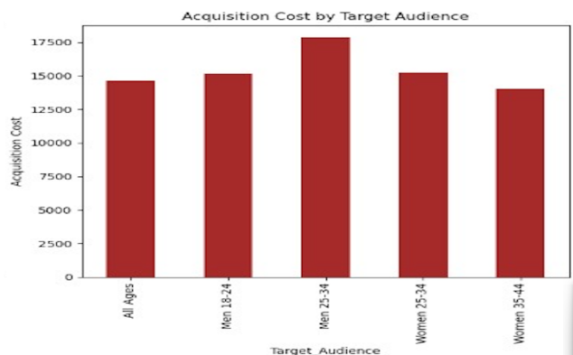
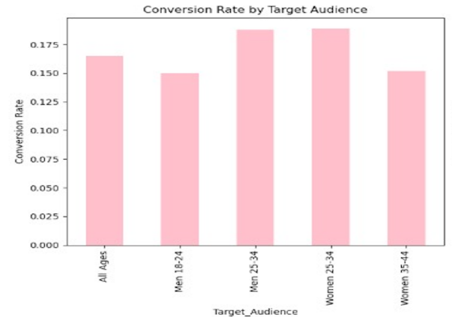
Exploratory Data Analysis
Acquisition Cost by Target Audience
Conversion Rate by Target Audience

Slide 12
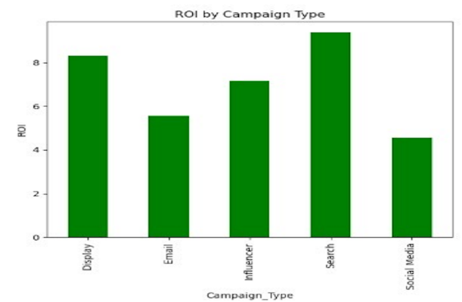
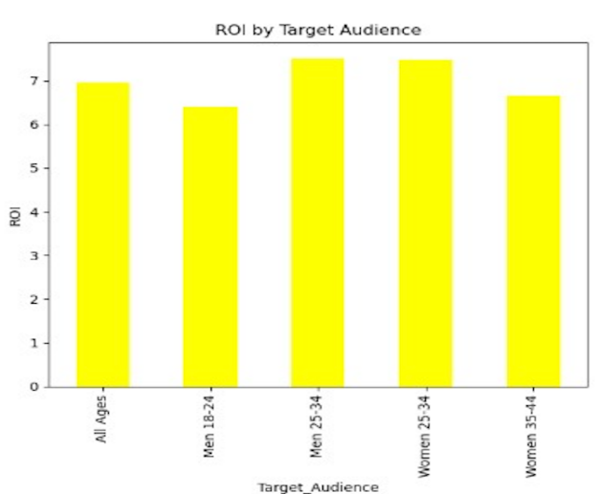
Exploratory Data Analysis
ROI by Campaign Type
ROI by Target Audience

Slide 13
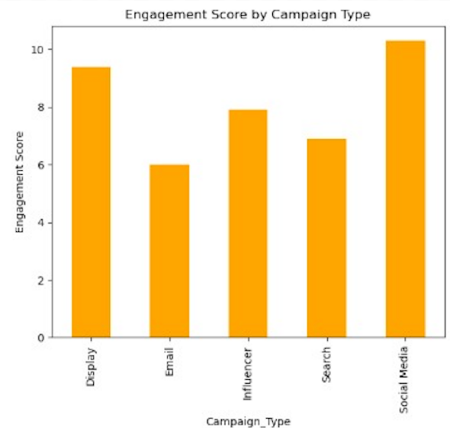
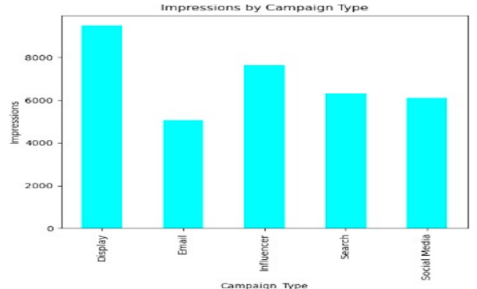
Exploratory Data Analysis
Engagement Score by Campaign Type
Impressions and Clicks by Campaign Type

Slide 14
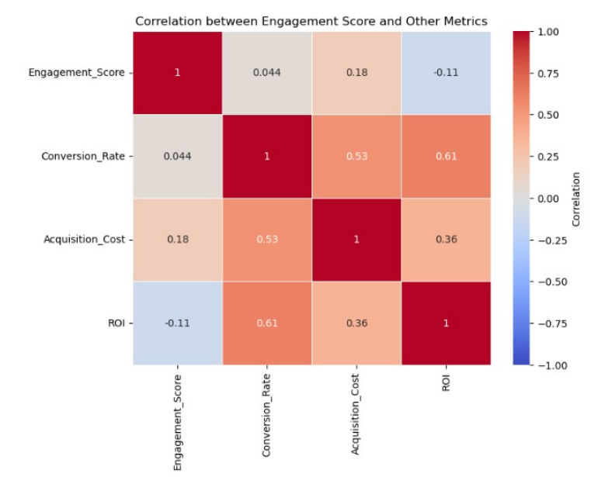
Exploratory Data Analysis
Correlation Insights

Slide 15
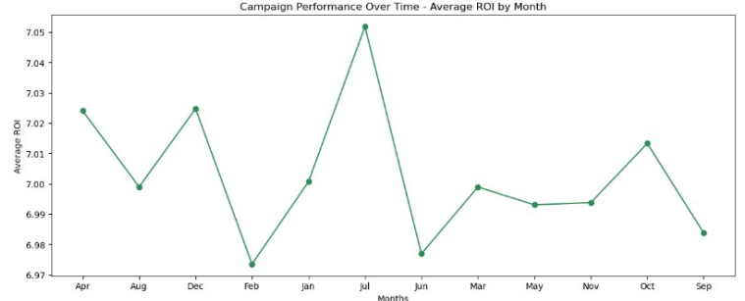
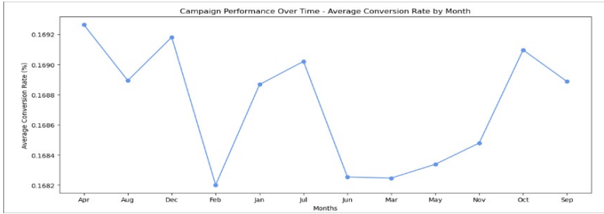
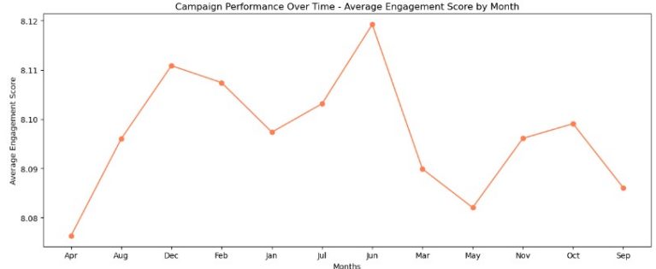
Exploratory Data Analysis
Seasonal Performance
Monthly ROI Trends
Monthly Conversion Rate Trends
Monthly Engagement Trends

Slide 16
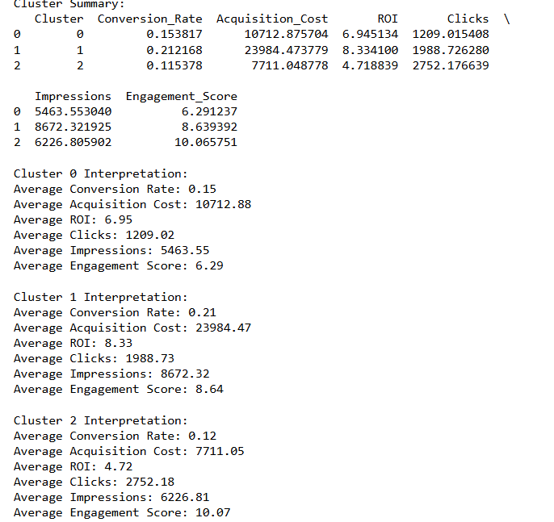
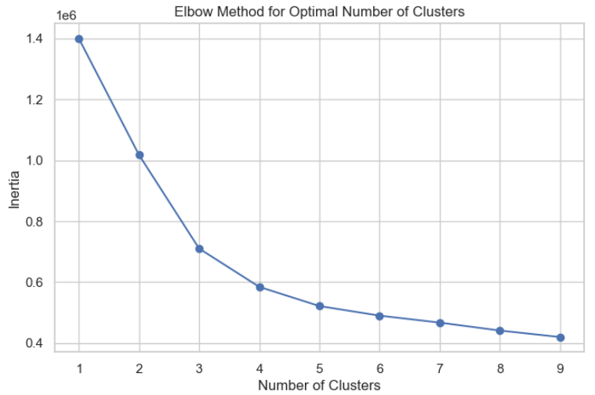
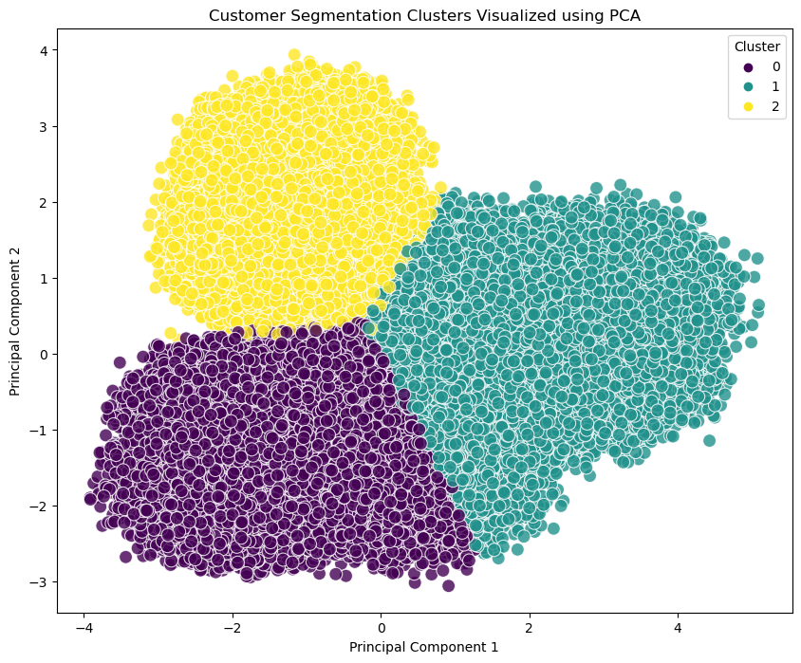
Customer Segmentation Analysis
Elbow method to decide clusters
Summary…
CLUSTER 0:
MODERATE
Cost Efficiency Focus
Targeted Content to boost engagement
Retention Focus
CLUSTER 1:
HIGH
Increased investment in premium campaigns
Focus on high quality content
Customer retention programs
CLUSTER 2:
LOW CONVERSION AND ACQUISITION, HIGH ENGAGEMENT
Cost effective marketing
Incentivize conversion with offers
Nurturing campaigns

Slide 17
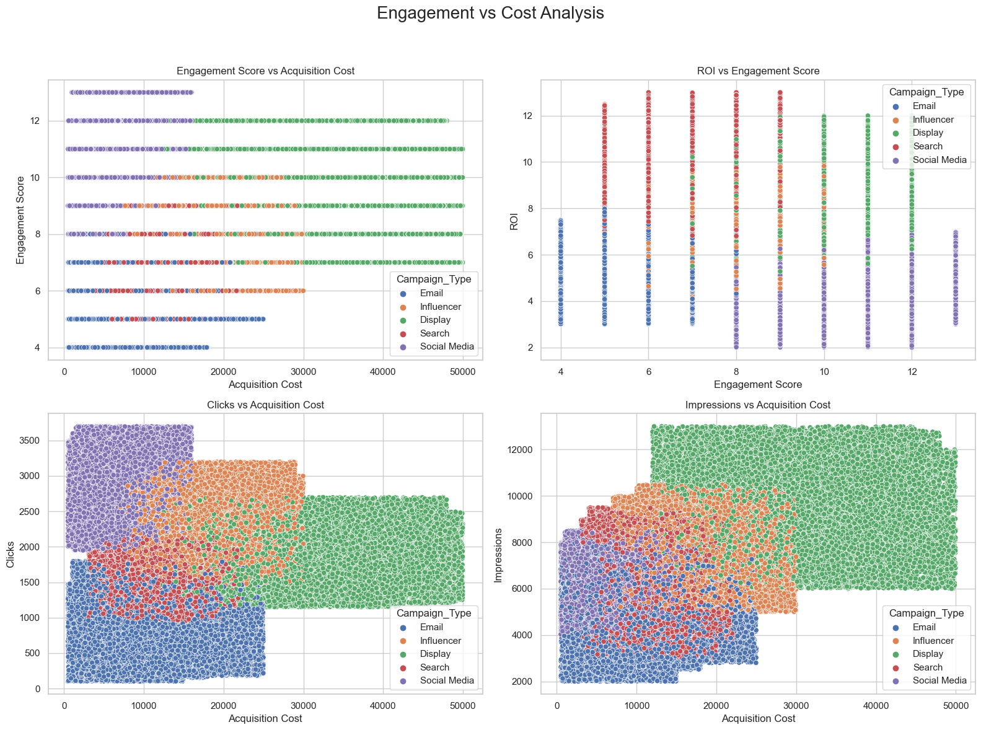
Engagement directly proportional to the money invested?
Engagement Score vs Acquisition Cost
ROI VS Engagement Score
Clicks vs Acquisition Cost
Impressions vs Acquisition Cost

Slide 18
Display - Instagram vs. Social Media - Instagram: -
T-statistic: 204.88
P-value -
Display campaigns on Instagram have a significantly different (either higher or lower) Conversion Rate compared to Social Media campaigns on Instagram. This could imply that Instagram audiences respond very differently to Display ads versus Social Media ads, suggesting that Display ads might need a different strategy or targeting.
Display - Email vs. Social Media – Email: -
T-statistic: 202.53
P-value -
This test shows that even within the same channel (Email), Display and Social Media campaigns yield significantly different Conversion Rates. This suggests that the content format (Display vs. Social Media) influences user engagement in Email campaigns.
A/B TESTING
Display - YouTube vs. Social Media - Instagram: -
T-statistic: 202.98
P-value -
Display ads on YouTube perform differently in terms of Conversion Rate compared to Social Media ads on Instagram, indicating that YouTube users may have different expectations or engagement levels with Display ads.
Display - Google Ads vs. Social Media - Instagram:
T-statistic: 202.34
P-value -
Display campaigns on Google Ads show a significant Conversion Rate difference compared to Social Media campaigns on Instagram, highlighting that users on Google and Instagram might have differing levels of interest or interaction with these ad formats.

Slide 19
Leverage Platform Strengths for Display Ads
Optimize Social Media Campaigns by Platform
Ad Placement Recommendations Based on Audience Behavior
Tailor Content for Email Campaigns
Experiment with Cross-Platform Campaigns
Test and Refine Content Types Regularly
Use Segmented Strategies for Higher Conversion Rates
RECOMMENDATIONS

Slide 20

Utilize Email for Cost Efficiency
Invest More in Display Ads
Target Key Demographics
RECOMMENDATIONS
& ACTIONS
Plan Seasonally
Optimize Channel Usage
Implement Loyalty Programs

Slide 21



Advanced Analytics Implementation Predictive Modeling Sentiment Analysis
FUTURE SCOPE
Deeper Customer Segmentation Micro-Segmentation
Lifecycle Stage Marketing
Integration of Emerging Technologies Artificial Intelligence
Augmented Reality and Virtual Reality
Data Quality and Availability Incomplete Data
Historical Data Bias
LIMITATIONS
Consumer Behavior Complexity Unpredictable Consumer Behavior Psychological Factors
Dynamic Market Conditions Rapid Market Changes Technological Advancements

Slide 22

THANK YOU
GROUP 7
SAI GAGAN SHAKAMURI
SHREY SANDEEP JAIN
KISHORE KUMAR SURESH
VIKRAM RATAN
JITIN NAIDU KONDIPATI

